Slide 1
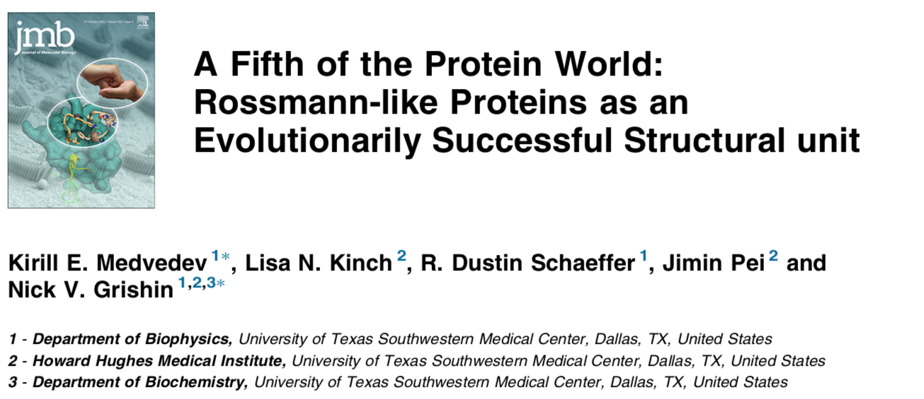

Slide 2
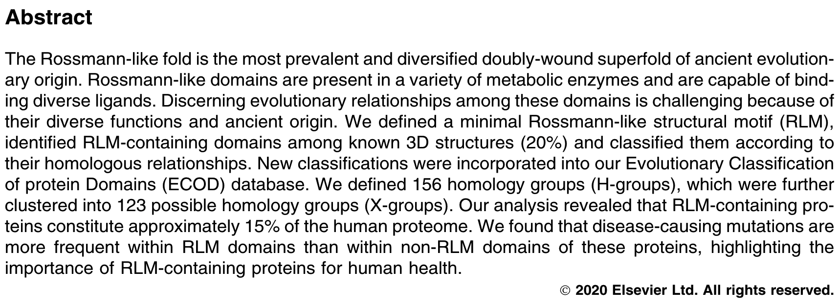
Notes:
=> After classification about 39,000 protein structure was recognized as RLM structure.
(Total protein in PDB 190,000)

Slide 3
Outline
Background
Amino acid to protein
Protein structure (protein folding)
Primary and Secondary structure of Protein
Tertiary structure of Protein
Protein Classification
Application

Slide 4
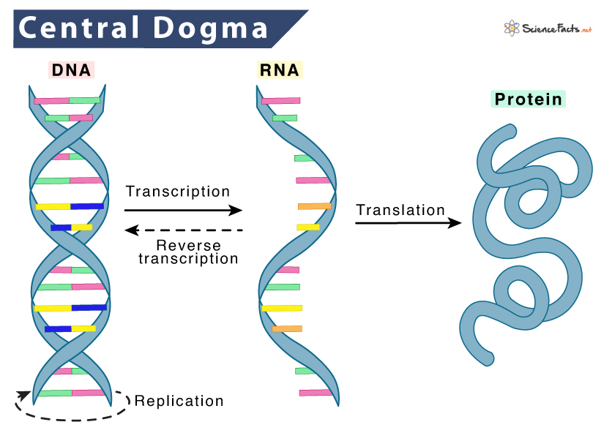
https://en.wikipedia.org/wiki/Transfer_RNA

Slide 5
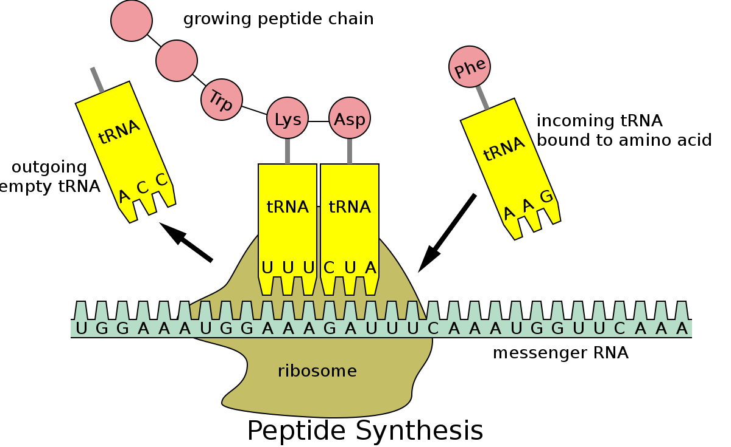
Polypeptide Synthesis by Ribosome
Peptide
mRNA
https://en.wikipedia.org/wiki/Transfer_RNA

Slide 6
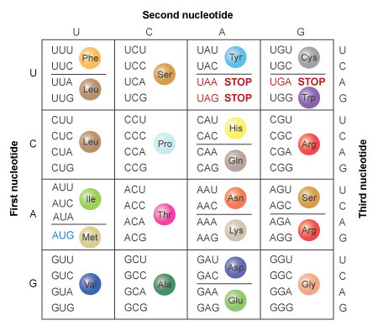
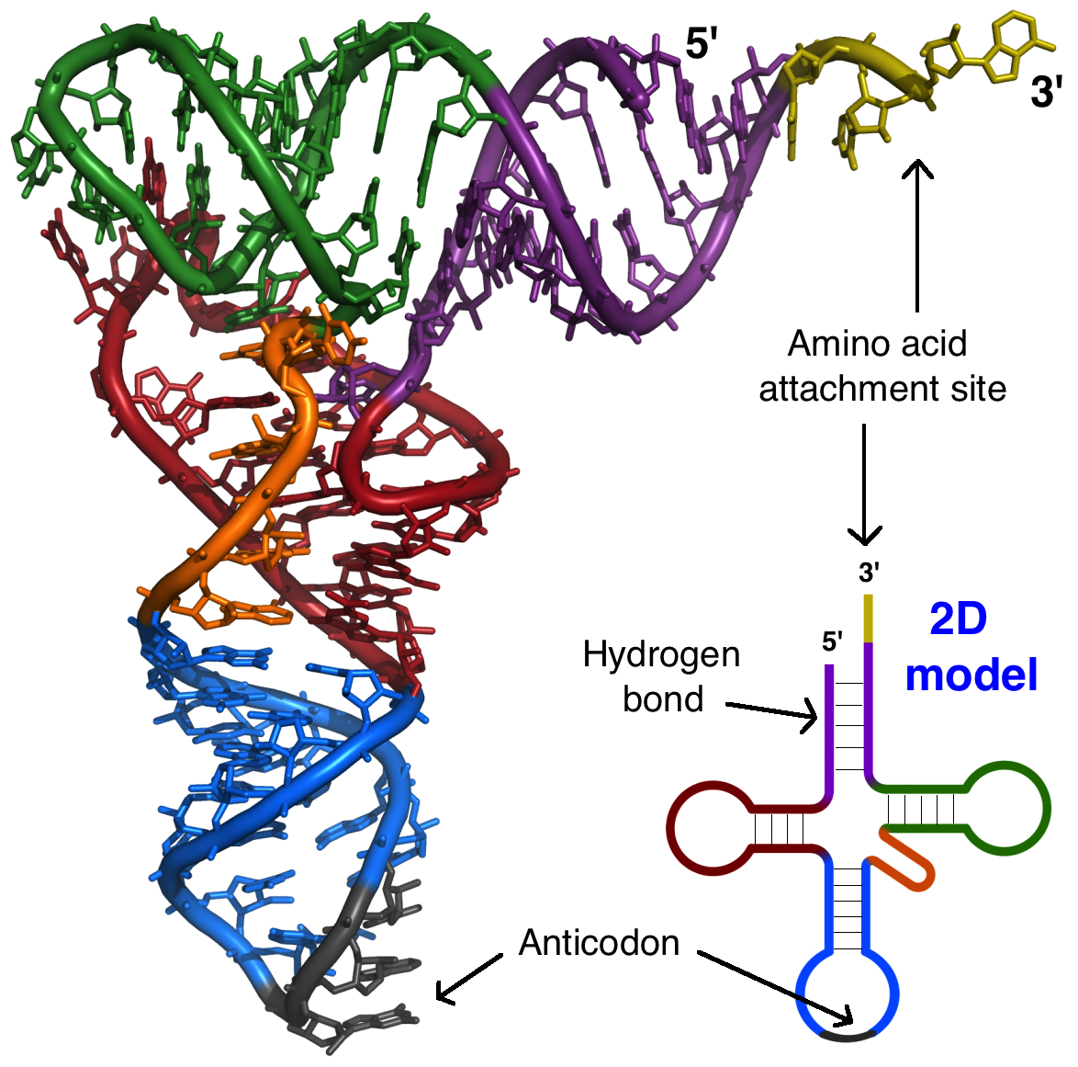
Translation: from RNA codon to amino acid
tRNA
Codon
© 2014 Nature Education All rights reserved.

Slide 7
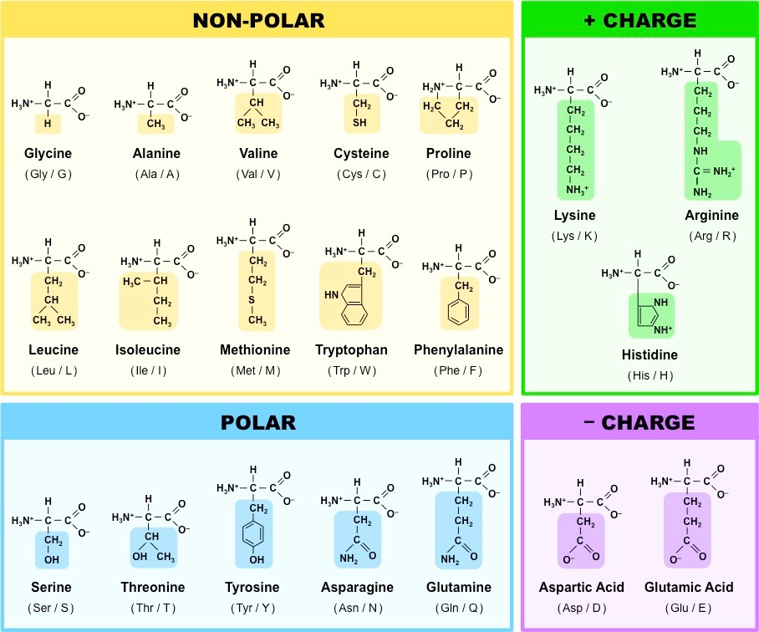
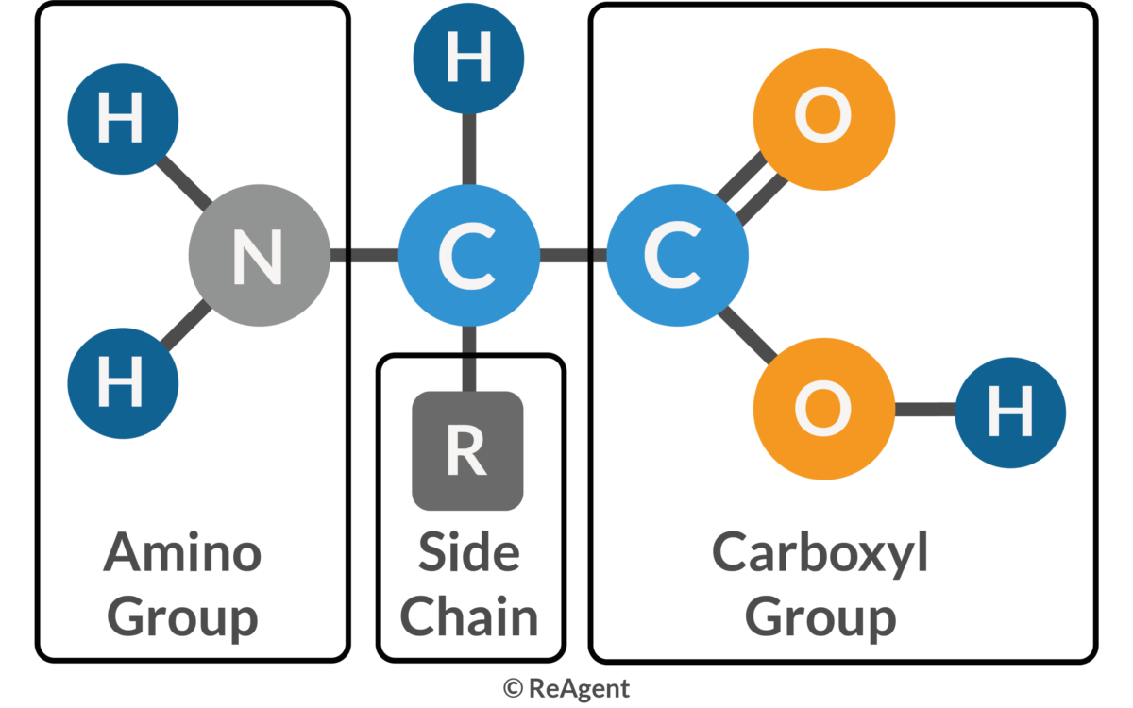
Amino Acid
https://www.reagent.co.uk/what-are-amino-acids/
https://ib.bioninja.com.au/standard-level/topic-2-molecular-biology/24-proteins/amino-acids.html

Slide 8
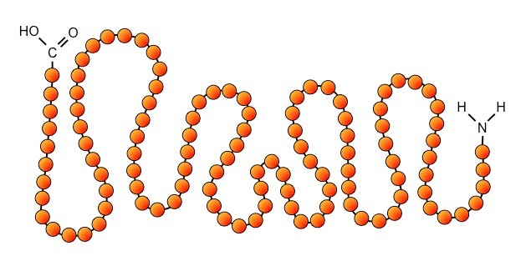
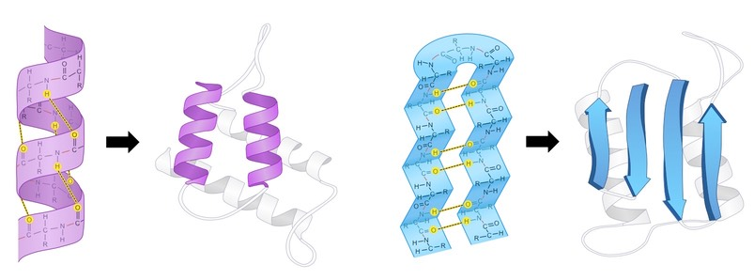
Protein Structure
Primary Structure
一級結構
Alpha helix
Beta sheet
Secondary Structure
二級結構
https://ib.bioninja.com.au/higher-level/topic-7-nucleic-acids/73-translation/protein-structure.html
Notes:
序列backbone 上的氫鍵互相鍵結形成二級結構

Slide 9
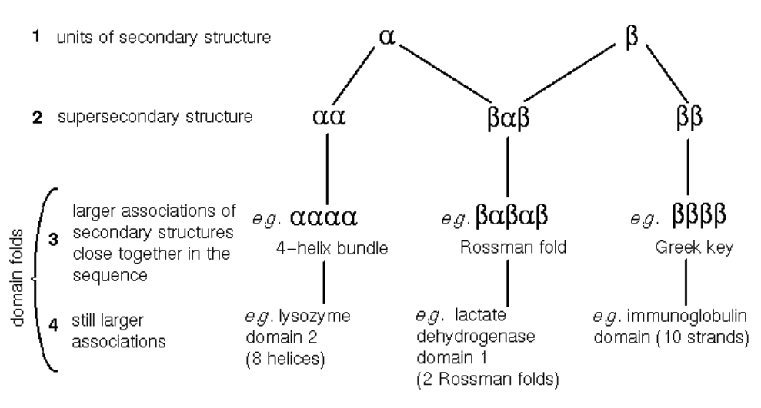
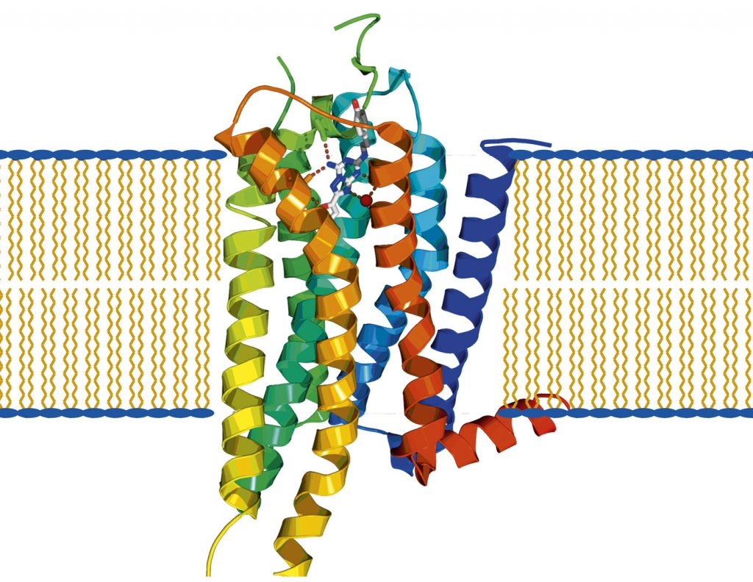
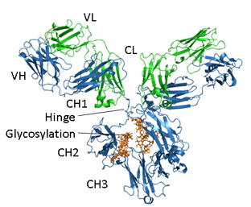
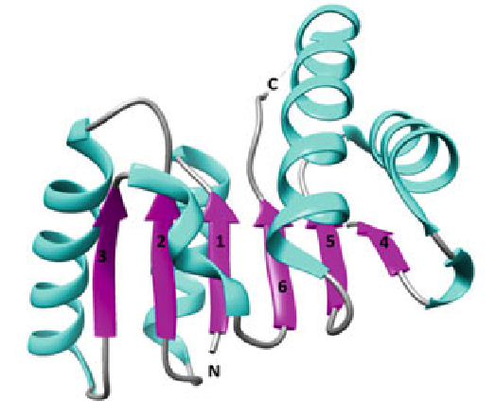
Tertiary Structure 三級結構
https://www.cryst.bbk.ac.uk/PPS2/course/index.html
https://absoluteantibody.com/antibody-resources/antibody-overview/antibody-structure/
https://researchfeatures.com/challenges-and-solutions-g-protein-coupled-receptors-as-novel-drug-targets/
GPCR
malate dehydrogenase
Antibody--IgG
Notes:
複數的二級結構的堆疊排列形成有功能的蛋白質三級結構

Slide 10
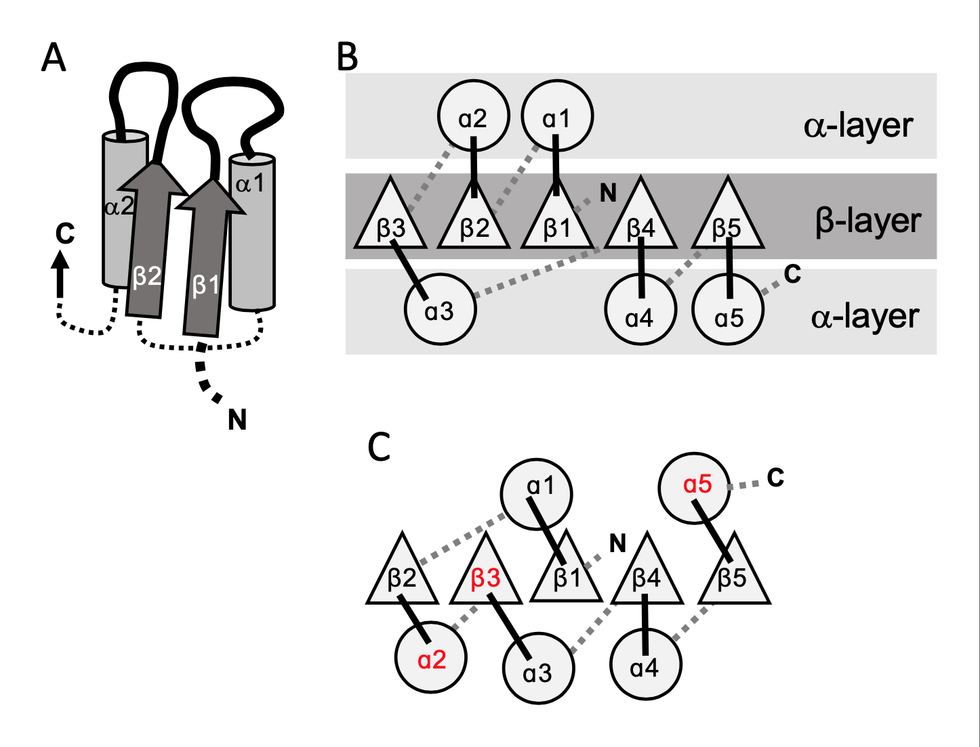
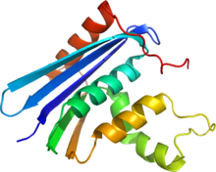
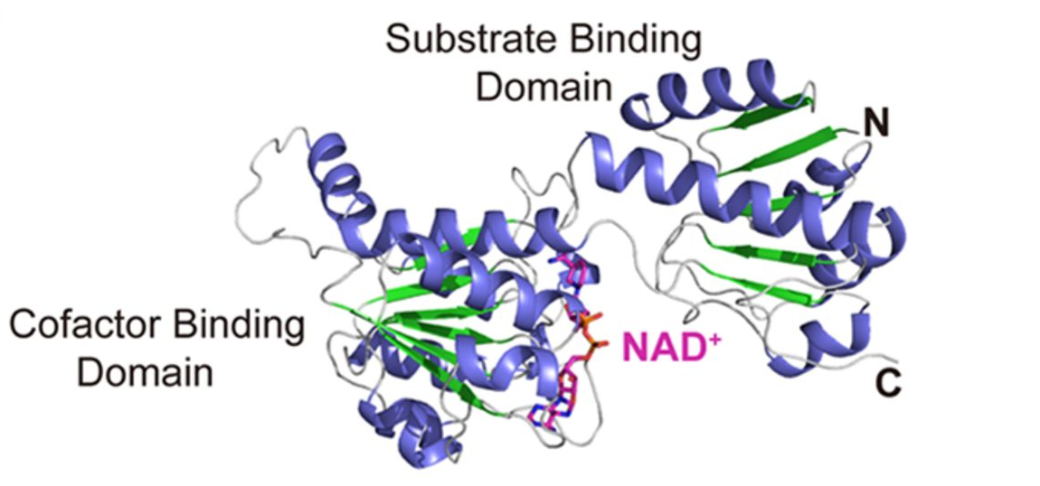
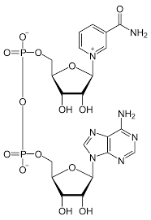
Rossmann Fold
E. coli ribonuclease H1 (Rnase H1)
Lactate Dehydrogenase
NAD+
Double Wound Topology
Longo et al. eLife 2020;9:e64415. DOI:https://doi.org/10.7554/eLife.64415
Notes:
乳酸去氫酶 Lactate Dehydrogenase

Slide 11
2014
ECOD: an evolutionary classification of protein domains
2018
Functional and evolutionary analysis of viral proteins containing a Rossmann‐like fold
2019
EVOLUTIONARY ANALYSIS OF ROSSMANN-LIKE FOLD PROTEINS
2019
Functional analysis of Rossmann-like domains reveals convergent evolution of topology and reaction pathways
2020
Rossmann-Like Proteins Function and Evolution Analysis of a Fifth of the Protein World
2021
A fifth of the protein world: Rossmann-like proteins as an evolutionarily successful structural unit

Slide 12


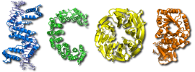
Structural Classification Database
Structural Classification of Proteins
Class, Architecture, Topology, Homology
ECOD
Evolutionary Classification of protein Domains

Slide 13
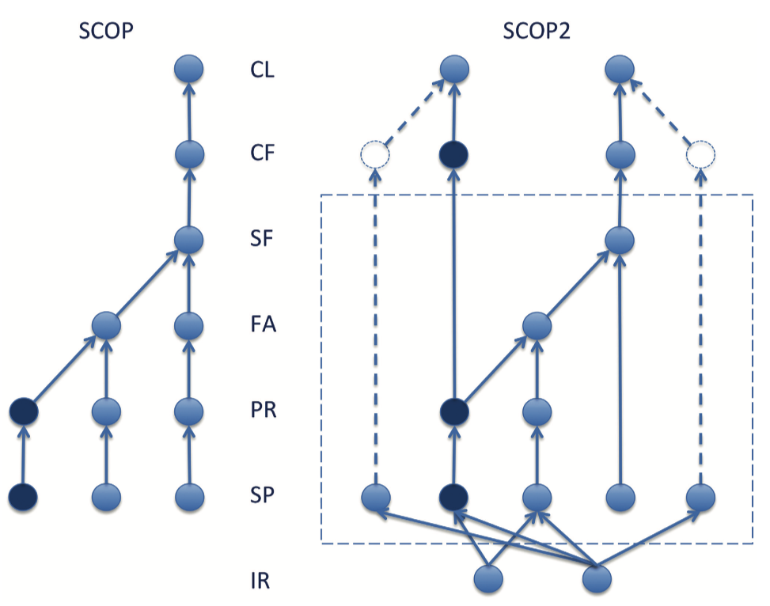
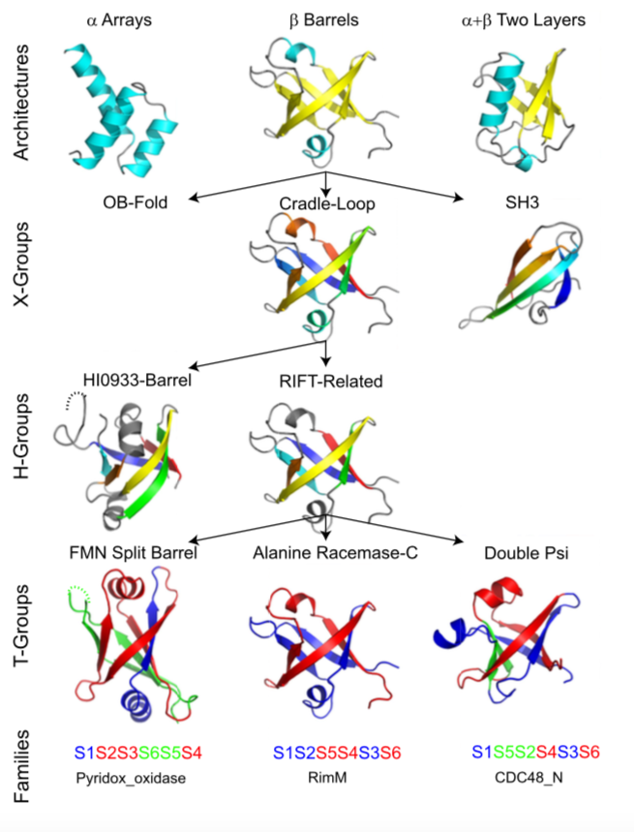
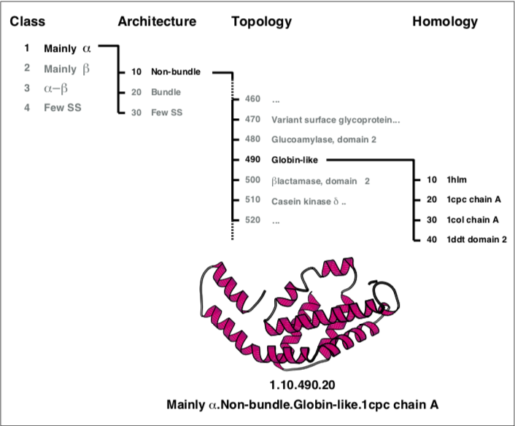
Structural Classification
SCOP
ECOD
CATH
Class (CL)
Fold (CF)
Superfamily (SF)
Family (FA)
Protein (PR)
Protein species (SP)
“other” relationships (IR)
possible homology (X)
Homology (H)
Topology (T)
Family (F)

Slide 14
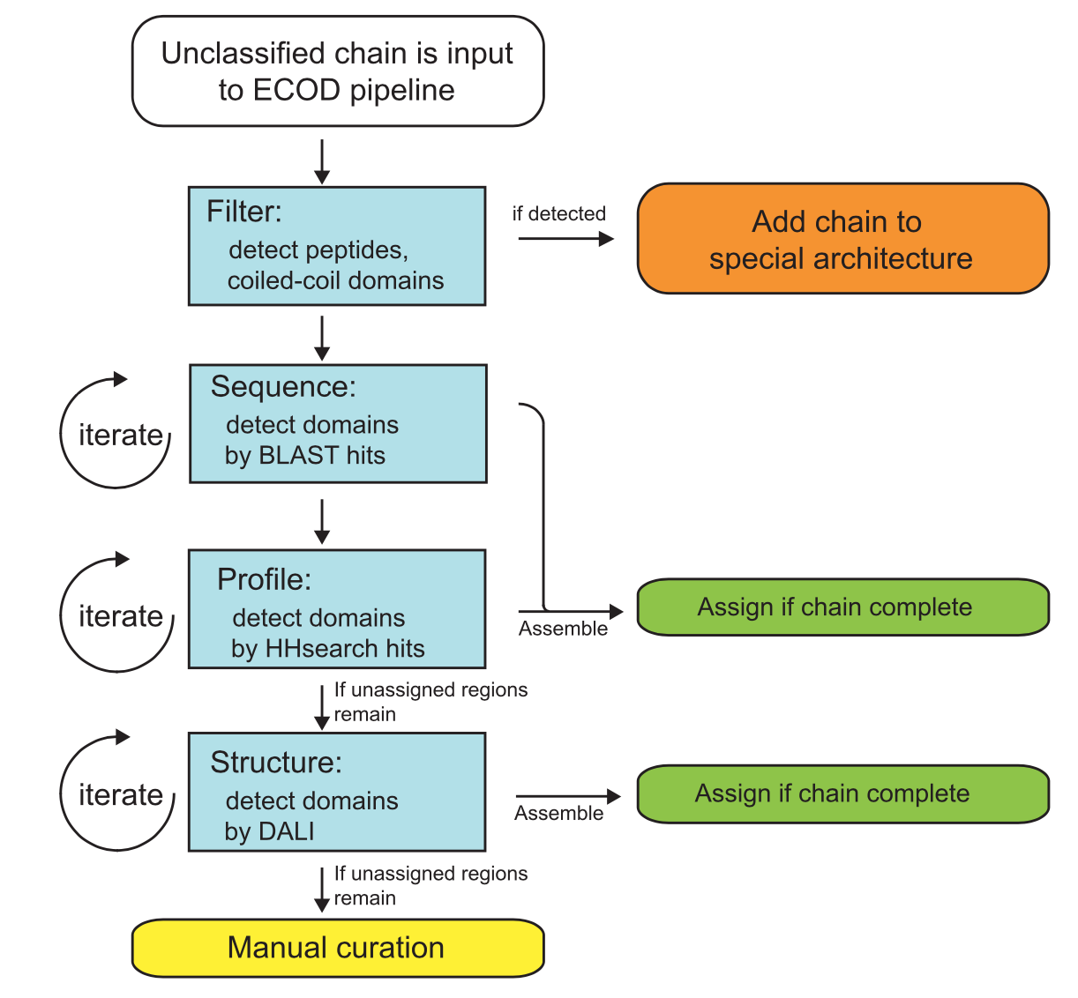
Evolutionary Classification of protein Domains (ECOD)
Sequence Wise
BLAST
Find local similarity between protein sequence. (DNA or protein sequence)
Hhsearch
Set the protein sequences as profile and run profile-profile search with hidden Markov model.
Structure Wise
DALI
Use secondary structure element
PALSSE
ProSMoS

Slide 15
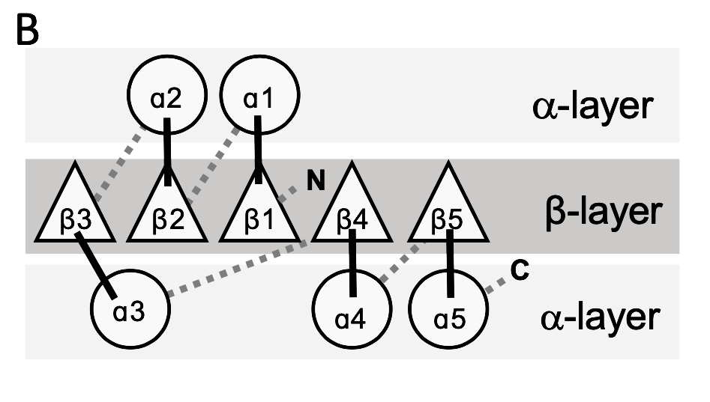
Miminal Rossmann-like Motif
一組相連的 β sheet + ⍺ helix
相連的Loop 通常具有功能
⍺1 之後有多種可能
⍺2 繞回來與前面的 β/⍺ 形成配對
⍺2 不強制為 ⍺ helix，也容許為β sheet
⍺2
β1
⍺1
βx
or
Loop

Slide 16
Workflow
Currently Total uploaded structures in PDB: 199,755
Transform
as SSE
RLM
search
~39,000
Protein with RLM
in PDB
Split into domains
117,000
Domains with RLM
156 homologous clusters
DALI
HHsearch
BLAST
RLM template

Slide 17
Application of RLM classification
1/5 known structure of proteins contain Rossmann-like motif
Considered the ligands, proteins with RLM shows a special case of convergent evolution
In human proteome, proteins with RLM constitute approximately 15%.
Disease-causing mutations show more frequent within RLM domain than non-RLM domain.
Notes:
不同的protein 演化出類似的topology 去與核醣結合 ，他們覺得這是一種在演化上收斂的現象

